Slide 1

Neurologic Emergencies
CHAPTER 18

Slide 2
National EMS Education Standard Competencies (1 of 3)
Medicine
Applies fundamental knowledge to provide basic emergency care and transportation based on assessment findings for an acutely ill patient.
Notes:
National EMS Education Standard Competencies
Medicine
Applies fundamental knowledge to provide basic emergency care and transportation based on assessment findings for an acutely ill patient.

Slide 3
National EMS Education Standard Competencies (2 of 3)
Neurology
Anatomy, presentations, and management of
  Decreased level of responsiveness
  Seizure
  Stroke
Notes:
National EMS Education Standard Competencies
Neurology
Anatomy, presentations, and management of
• Decreased level of responsiveness
• Seizure
• Stroke

Slide 4
National EMS Education Standard Competencies (3 of 3)
Neurology (cont’d)
Anatomy, physiology, pathophysiology, assessment, and management of
  Stroke/transient ischemic attack
  Seizure
  Status epilepticus
  Headache
Notes:
National EMS Education Standard Competencies
Anatomy, physiology, pathophysiology, assessment, and management of
• Stroke/transient ischemic attack
• Seizure
• Status epilepticus
• Headache

Slide 5
Introduction (1 of 3)
Stroke is the fifth-leading cause of death and the leading cause of adult disability in the United States.
  Common in geriatric patients
  Contributing factors for stroke include family history and race.
  New treatments are available.
Notes:
Lecture Outline
I. Introduction
A. Stroke is the fifth-leading cause of death and the leading cause of adult disability in the United States, according to the American Stroke Association.
1. It is common in geriatric patients.
2. Contributing factors for stroke include family history and race.
3. New treatments are available for stroke.

Slide 6
Introduction (2 of 3)
Seizures and altered mental status may also occur.
Seizures may occur as a result of:
  Recent or prior head injury
  A brain tumor
  Metabolic problems
  Fever
  A genetic disposition
Notes:
Lecture Outline
B. Seizures and altered mental status may also occur when there is a disorder in the brain.
1. Seizures may occur as a result of:
a. Recent or prior head injury
b. Brain tumor
c. Metabolic problems
d. Fever
e. A genetic disposition

Slide 7
Introduction (3 of 3)
Possible causes of altered mental status include:
  Intoxication
  Head injury
  Hypoxia
  Stroke
  Metabolic disturbances
Treatment varies widely.
Notes:
Lecture Outline
2. Possible causes of altered mental status include:
a. Intoxication
b. Head injury
c. Hypoxia
d. Stroke
e. Metabolic disturbances
3. Treatment varies widely.

Slide 8
Anatomy and Physiology (1 of 7)
The brain is the body’s computer.
  Controls breathing, speech, and all body functions
Three major parts: brainstem, cerebellum, and cerebrum
  The cerebrum is the largest part.
Notes:
Lecture Outline
II. Anatomy and Physiology
A. The brain is the body’s computer.
1. It controls breathing, speech, and all other body functions.
2. There are three major parts: brainstem, cerebellum, and cerebrum.
a. The cerebrum is the largest part.

Slide 9
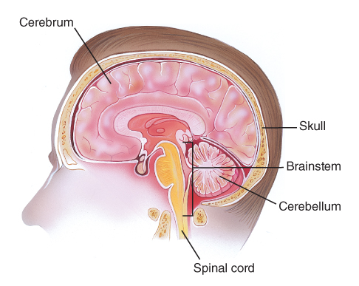
Anatomy and Physiology (2 of 7)
FIGURE 18-1 The brain is well protected within the skull. The brain’s major parts are the cerebrum, the cerebellum, and the brainstem
© Jones & Bartlett Learning.
Notes:
The figure on this slide illustrates the three major parts of the brain: the cerebrum, the cerebellum, and the brainstem.

Slide 10
Anatomy and Physiology (3 of 7)
The brainstem controls the most basic functions.
  Breathing, blood pressure, swallowing, pupil constriction
The cerebellum controls muscle and body coordination.
Notes:
Lecture Outline
b. The brainstem controls the most basic functions.
i. Breathing, blood pressure, swallowing, pupil constriction
c. The cerebellum controls muscle and body coordination.

Slide 11
Anatomy and Physiology (4 of 7)
The cerebrum is divided into right and left hemispheres.
  Each controls activities on the opposite side of the body.
  The front of the cerebrum controls emotion and thought.
  The middle controls sensation and movement.
  The back processes sight.
Notes:
Lecture Outline
d. The cerebrum, located above the cerebellum, is divided into right and left hemispheres.
i. Each controls activities on the opposite side of the body.
ii. The front of the cerebrum controls emotion and thought.
iii. The middle part controls sensation and movement.
iv. The back processes sight.

Slide 12
Anatomy and Physiology (5 of 7)
In most people, speech is controlled on the left side of the brain near the middle of the cerebrum.
Messages sent to and from the brain travel through nerves.
  Twelve cranial nerves run directly from the brain to parts of the head.
Notes:
Lecture Outline
v. In most people, speech is controlled on the left side of the brain near the middle of the cerebrum.
B. Messages sent to and from the brain travel through nerves.
1. Twelve cranial nerves run directly from the brain to parts of the head.

Slide 13
Anatomy and Physiology (6 of 7)
The rest of the nerves join in the spinal cord and exit the brain through a large opening in the base of the skull called the foramen magnum.
  At each vertebra in the neck and back, two nerves branch out (spinal nerves).
  These carry signals to and from the body.
Notes:
Lecture Outline
2. The rest of the nerves join in the spinal cord and exit the brain through a large opening in the base of the skull called the foramen magnum.
3. At each vertebra in the neck and back, two nerves branch out from the spinal cord and carry signals to and from the spinal cord.

Slide 14
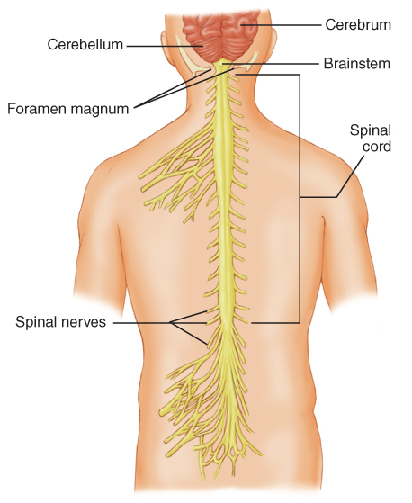
Anatomy and Physiology (7 of 7)
FIGURE 18-2 The spinal cord is the continuation of the
brainstem. It exits the skull at the foramen magnum and
extends down to the level of the second lumbar vertebra.
© Jones & Bartlett Learning.
Notes:
The figure on this slide illustrates the intersection of the skull and spinal cord. The spinal cord exits the skull at the foramen magnum, and two nerves branch out of the spinal cord at each vertebra in the neck and back.

Slide 15
Pathophysiology
Many different disorders may cause brain dysfunction.
  May affect the patient’s level of consciousness, speech, and voluntary muscle control
The brain is sensitive to changes in oxygen, glucose, and temperature.
Notes:
Lecture Outline
III. Pathophysiology
A. Many different disorders may cause brain dysfunction and may affect the patient’s level of consciousness, speech, and voluntary muscle control.
The brain is most sensitive to changes in oxygen, glucose, and temperature levels.
1. A significant change in any one of these levels will result in a neurologic change.

Slide 16
Headache (1 of 5)
One of the most common complaints
Can be a symptom of another condition or a neurologic condition on its own
Only a small percentage of headaches are caused by a serious medical condition.
Tension headaches, migraines, and sinus headaches are the most common.
Notes:
Lecture Outline
IV. Headache
A. One of the most common complaints you will hear from your patients in terms of pain is headache.
1. Headache can be a symptom of another condition or it can be a neurologic condition on its own.
2. Only a small percentage of headaches are caused by a serious medical condition.
3. Tension headaches, migraines, and sinus headaches are the most common types of headaches.

Slide 17
Headache (2 of 5)
Tension headaches
  Caused by muscle contractions in the head and neck
  Attributed to stress
  Pain is usually described as squeezing, dull, or as an ache.
  Usually do not require medical attention
Notes:
Lecture Outline
B. Tension headaches
a. Caused by muscle contractions in the head and neck and are attributed to stress.
b. The pain is usually described as squeezing, dull, or as an ache.
c. Usually do not require medical attention

Slide 18
Headache (3 of 5)
Migraine headaches
  Thought to be caused by changes in blood vessel size in the base of the brain.
  Pain is usually described as pounding, throbbing, and pulsating.
  Often associated with nausea and vomiting, and may be preceded by visual changes
  Can last for several hours or days
Notes:
Lecture Outline
C. Migraine headaches
1. Are thought to be caused by changes in the blood vessel size in the base of the brain.
2. The pain is usually described as pounding, throbbing, and pulsating.
3. Often associated with nausea and vomiting and may be preceded by visual warning signs such as flashing lights or partial vision loss.
4. Migraine headaches can last for several hours to days.

Slide 19
Headache (4 of 5)
Sinus headaches
  Caused by pressure that is the result of fluid accumulation in the sinus cavities
  Patients may also have cold-like symptoms of nasal congestion, cough, and fever.
  Prehospital emergency care is not required.
Notes:
Lecture Outline
D. Sinus headaches are caused by pressure that is the result of fluid accumulation in the sinus cavities.
1. Patients may also have cold-like signs and symptoms of nasal congestion, cough, and fever.
2. Prehospital emergency care is not required.

Slide 20
Headache (5 of 5)
Serious conditions that include headache as a symptom are hemorrhagic stroke, brain tumor, and meningitis.
Notes:
Lecture Outline
E. Serious conditions that include headache as a symptom are hemorrhagic stroke, brain tumor, and meningitis.

Slide 21
Stroke
Also called a cerebrovascular accident (CVA)
Interruption of blood flow to an area within the brain
Results in the loss of brain function
There are two main types of stroke: ischemic and hemorrhagic.
Notes:
Lecture Outline
V. Stroke
A. A cerebrovascular accident (CVA), or stroke, is an interruption of blood flow to an area within the brain that results in the loss of brain function.

Slide 22
Ischemic Stroke (1 of 2)
Most common, accounting for 87% of strokes
Results from thrombosis or an embolus
Symptoms may range from nothing at all to complete paralysis.
Atherosclerosis in the blood vessels is often the cause.
Notes:
Lecture Outline
1. Ischemic stroke
a. Most common, accounting for 87% of strokes
b. Results from a thrombosis or an embolus
c. Symptoms may range from nothing at all to complete paralysis.
d. Atherosclerosis in the blood vessels is often the cause.

Slide 23
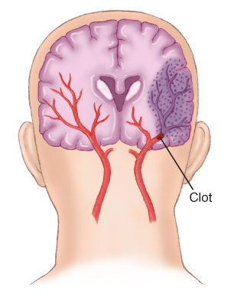
Ischemic Stroke (2 of 2)
FIGURE 18-3 Atherosclerosis can damage the wall of a
cerebral artery, producing narrowing and/or a blood clot.
When a vessel is narrowed or completely blocked, blood
flow to part of the brain may be blocked, causing brain
cells to die because of the lack of adequate oxygenation.
© Jones & Bartlett Learning.
Notes:
Illustration showing ischemic stroke.

Slide 24
Hemorrhagic Stroke (1 of 2)
Accounts for 13% of strokes
Results from bleeding inside the brain
Cerebral hemorrhages are often fatal.
People at high risk include those experiencing stress or exertion.
People at highest risk are those who have very high blood pressure.
Notes:
Lecture Outline
2. Hemorrhagic stroke
a. Accounts for 13% of strokes
b. Results from bleeding inside the brain
c. Cerebral hemorrhages are often fatal.
d. People at high risk include those experiencing stress or exertion.
e. People at highest risk are those who have very high blood pressure or long-term elevated blood pressure that is not treated.

Slide 25
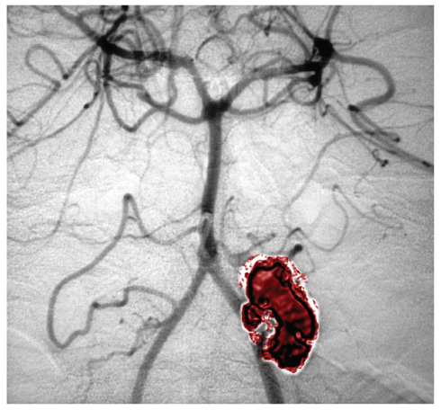
Hemorrhagic Stroke (2 of 2)
Aneurysm
  Swelling or enlargement of the wall of an artery resulting from a defect or weakening of the arterial wall
FIGURE 18-5 An angiogram showing a cerebral aneurysm
© Living Art Enterprises/Photo Researchers, Inc.
Notes:
Lecture Outline
e. Berry aneurysms are a common cause of hemorrhagic strokes in healthy, young people.
i. Presents as the “worst headache of their life”
ii. Causes a subarachnoid hemorrhage

Slide 26
Transient Ischemic Attack (TIA)
Stroke-like symptoms go away on their own in less than 24 hours.
May be a warning sign of a larger stroke to come
About one-third of patients who have a TIA will experience a stroke.
Notes:
Lecture Outline
3. Transient ischemic attack (TIA)
a. Stroke-like symptoms go away on their own in less than 24 hours.
b. May be a warning sign of a larger stroke to come and is considered an emergency.
c. About one-third of patients who have a TIA will experience a stroke soon after.
d. All patients with a TIA should be evaluated by a physician.

Slide 27
Signs and Symptoms of Stroke (1 of 4)
Facial drooping
Sudden weakness or numbness in the face, arm, leg, or one side of body
Decreased or absent movement and sensation on one side of the body
Lack of muscle coordination (ataxia) or loss of balance
Notes:
Lecture Outline
C. Signs and symptoms of stroke
1. General signs and symptoms include the following:
a. Facial drooping
b. Sudden weakness or numbness in the face, arm, leg, or one side of the body
c. Decreased or absent movement and sensation on one side of the body
d. Lack of muscle coordination (ataxia) or loss of balance

Slide 28
Signs and Symptoms of Stroke (2 of 4)
Sudden vision loss in one eye
Blurred and double vision
Difficulty swallowing
Decreased level of responsiveness
Speech disorders
Notes:
Lecture Outline
e. Sudden vision loss in one eye, or blurred and double vision
f. Difficulty swallowing
g. Decreased level of responsiveness
h. Speech disorders

Slide 29
Signs and Symptoms of Stroke (3 of 4)
Aphasia
Slurred speech (dysarthria)
Sudden and severe headache
Confusion
Dizziness
Notes:
Lecture Outline
i. Aphasia: difficulty expressing thoughts or inability to use the right words (expressive aphasia) or difficulty understanding spoken words (receptive aphasia)
j. Slurred speech (dysarthria)
k. Sudden and severe headache
l. Confusion
m. Dizziness

Slide 30
Signs and Symptoms of Stroke (4 of 4)
Weakness
Combativeness
Restlessness
Tongue deviation
Coma
Notes:
Lecture Outline
n. Weakness
o. Combativeness
p. Restlessness
q. Tongue deviation
r. Coma

Slide 31
Left Hemisphere
Stroke in the left cerebral hemisphere may cause aphasia.
  Inability to produce or understand speech
  Speech problems can vary widely.
May also cause paralysis of the right side of the body
Notes:
Lecture Outline
2. Left hemisphere
a. Stroke in the left cerebral hemisphere may cause aphasia.
i. Aphasia is the inability to produce or understand speech.
ii. Speech problems can vary widely.
b. Strokes that affect the left side of the brain can also cause paralysis of the right side of the body.

Slide 32
Right Hemisphere
Stroke may cause paralysis of the left side of the body.
Usually, patients can understand language and are able to speak.
Patients may be oblivious to their problem (neglect).
Neglect and lack of pain cause many patients to delay seeking help.
Notes:
Lecture Outline
3. Right hemisphere
a. Strokes that affect the right side of the brain can cause paralysis of the left side of the body.
b. Usually, patients will understand language and be able to speak, but their words may be slurred and hard to understand.
c. Patients may be oblivious to their problem; this symptom is called neglect.
d. May neglect certain parts of their vision.
e. Neglect and lack of pain cause many patients to delay seeking help.

Slide 33
Bleeding in the Brain
Patients may have high blood pressure.
  May be the cause of the bleeding
  May be caused by the bleeding, as a compensatory response
Increasing blood pressure is an important sign.
Significant drops in blood pressure may occur as the patient’s condition worsens.
Notes:
Lecture Outline
4. Bleeding in the brain
a. Patients may have very high blood pressure.
i. May be the cause of the bleeding
ii. May be caused by the bleeding, as a compensatory response
b. A trend of increasing blood pressure is an important sign, as the body must increase the blood pressure to get blood to the brain’s tissues.
c. Significant drops in blood pressure may occur as the patient’s condition worsens.

Slide 34
Conditions That May Mimic Stroke (1 of 2)
Hypoglycemia
Postictal state
Subdural or epidural bleeding
Notes:
Lecture Outline
D. Conditions that may mimic stroke
1. Hypoglycemia
2. Postictal state
3. Subdural or epidural bleeding

Slide 35
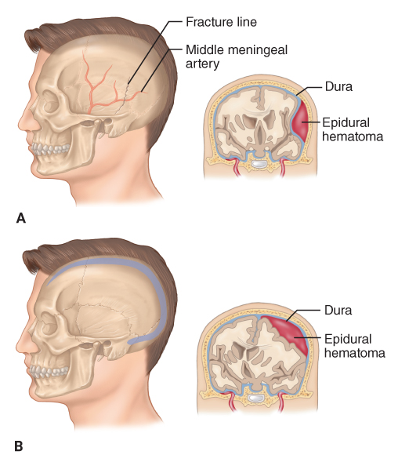
Conditions That May Mimic Stroke (2 of 2)
FIGURE 18-6 Trauma to the head may result in intracranial bleeding. A. Bleeding outside the dura and under the skull is called epidural bleeding. B. Bleeding beneath the dura but outside the brain is called subdural bleeding.
A, B: © Jones & Bartlett Learning.
Notes:
The figure on this slide illustrates intracranial bleeding. Trauma to the head may result in intracranial bleeding. Bleeding outside the dura and under the skull is called epidural bleeding, and bleeding beneath the dura but outside the brain is called subdural bleeding.

Slide 36
Seizures
A neurologic episode caused by a surge of electrical activity in the brain
Can take the form of a convulsion and/or can be associated with a temporary alteration in consciousness.
Two basic groups: generalized and partial (focal)
Notes:
Lecture Outline
VI. Seizures
A. A seizure is a neurologic episode caused by a surge of electrical activity in the brain.
1. In the United States, it is estimated that 3.5 million people have epilepsy.
2. Seizures are classified into two basic groups: generalized and partial (focal).

Slide 37
Generalized Seizure
Results from abnormal electrical discharges from large areas of the brain
Typically characterized by unconsciousness and a generalized severe twitching of all muscles lasting several minutes or longer
Notes:
Lecture Outline
2. Generalized (tonic-clonic) seizure
a. Results from abnormal electrical discharges from large areas of the brain, usually involving both hemispheres.
b. Typically characterized by unconsciousness and a generalized severe twitching of all muscles that lasts several minutes or longer.

Slide 38
Absence Seizure
Does not involve any changes in motor activity
Characterized by a brief lapse of consciousness in which the patient seems to stare and not respond
Notes:
Lecture Outline
3. Absence seizure
a. Does not involve any changes in motor activity.
b. Characterized by a brief lapse of consciousness in which the patient seems to stare and not respond.

Slide 39
Partial (Focal) Seizure (1 of 2)
Focal-onset aware seizure
  No change in the patient’s level of consciousness
  May have numbness, weakness, dizziness, visual changes, or unusual smells/tastes
  May have some twitching or brief paralysis
Notes:
Lecture Outline
4. Partial (focal) seizure
a. Focal-onset awareness seizure
i. No change in the patient’s level of consciousness
ii. Patients may have numbness, weakness, dizziness, visual changes, or unusual smells and tastes
iii. May also cause some twitching or brief paralysis

Slide 40
Partial (Focal) Seizure (2 of 2)
Focal-onset, impaired awareness seizure
  Altered mental status
  Results from abnormal discharges from the temporal lobe of the brain
  Lip smacking, eye blinking, isolated jerking
  Unpleasant smells, visual hallucinations, uncontrollable fear, repetitive physical behavior
Notes:
Lecture Outline
b. Focal-onset, impaired-awareness seizure
i. The patient has an altered mental status and does not interact normally with his or her environment.
ii. Results from abnormal discharges from the temporal lobe of the brain
iii. Other characteristics may be lip smacking, eye blinking, and isolated jerking.
iv. Patients also may experience unpleasant smells and visual hallucinations, exhibit uncontrollable fear, or perform repetitive physical behavior.

Slide 41
Aura
Patients may experience an aura prior to a seizure.
  Can include visual changes or hallucinations
People with a history of seizures recognize their auras and usually take steps to minimize injury.
Auras do not occur prior to every seizure, and not all patients with a seizure disorder experience an aura.
Notes:
Lecture Outline
5. Patients may experience a warning sign, aura prior to a seizure.
a. Can include visual changes or hallucinations.
b. People with a history of seizures recognize their auras and usually take steps to minimize injury, such as sitting or lying down.
c. Auras do not occur prior to every seizure, and not all patients with a seizure disorder experience an aura.

Slide 42
Generalized Seizure
Characterized by sudden loss of consciousness, chaotic muscle movement and tone, and apnea.
May exhibit bilateral muscle movement characterized by a cycle of muscle rigidity and relaxation
Typically lasts less than 5 minutes
Followed by a postictal state
Notes:
Lecture Outline
6. Generalized seizure
a. Characterized by sudden loss of consciousness followed by chaotic muscle movement and tone, and apnea.
b. May exhibit bilateral muscle movement characterized by a cycle of muscle rigidity and relaxation.
c. Typically last less than 5 minutes
d. Followed by a postictal state

Slide 43
Absence Seizure
Formerly called petit mal
May last for seconds
Patient fully recovers with a brief lapse of memory
Notes:
Lecture Outline
7. An absence (formerly called petit mal) seizure may last for just seconds, after which the patient fully recovers with only a brief lapse of memory of the event.

Slide 44
Status Epilepticus
Seizures lasting more than 5 minutes are likely to progress to status epilepticus.
Seizures that continue every few minutes without the person regaining consciousness or last longer than 30 minutes
Notes:
Lecture Outline
8. Status epilepticus
a. Seizures lasting more than 5 minutes are likely to progress to status epilepticus.
b. Seizures that continue every few minutes without the person regaining consciousness or last longer than 30 minutes.
9. Recurring or prolonged seizures should be considered immediately life-threatening situations.

Slide 45
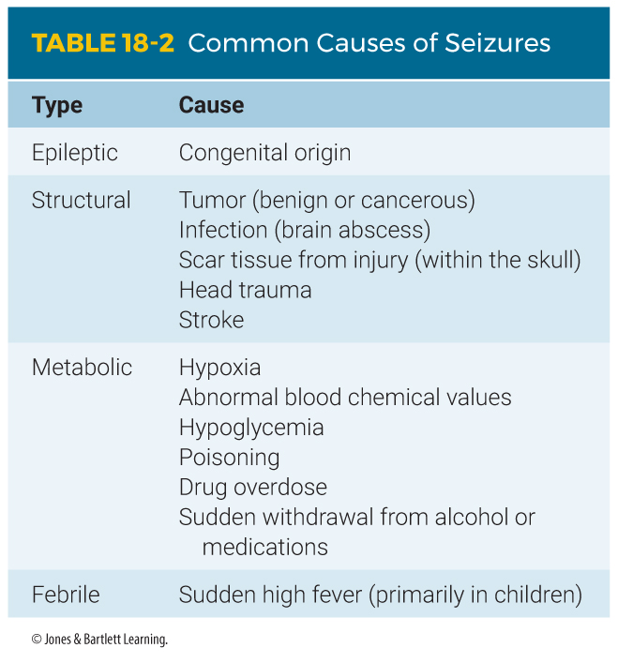
Causes of Seizures (1 of 2)
Notes:
Lecture Outline
B. Causes of seizures
1. Congenital
2. Structural
3. Metabolic
4. Febrile

Slide 46
Causes of Seizures (2 of 2)
Epileptic seizures usually can be controlled by medications.
  Levetiracetam (Keppra)
  Phenytoin (Dilantin)
  Phenobarbital
  Carbamazepine (Tegretol)
  Valproate (Depakote)
  Topiramate (Topamax)
  Clonazepam (Klonopin)
Notes:
Lecture Outline
5. Epileptic seizures usually can be controlled with medications.
a. Medications used most often to treat seizures include:
i. Levetiracetam (Keppra)
ii. Phenytoin (Dilantin)
iii. Phenobarbital
iv. Carbamazepine (Tegretol)
v. Valproate (Depakote)
vi. Topiramate (Topamax)
vii. Clonazepam (Klonopin)

Slide 47
The Importance of Recognizing Seizures
Recognize when a seizure is occurring and whether this episode differs from previous ones.
Recognize the postictal state and complications of seizures.
Identify other problems associated with seizures.
Notes:
Lecture Outline
C. The importance of recognizing seizures
1. Recognize when a seizure is occurring and whether this episode differs from previous ones.
2. Recognize the postictal state and complications of seizures.
3. Identify other problems associated with the seizure.

Slide 48
The Postictal State
After a seizure, the muscles relax and breathing becomes labored.
May be characterized by hemiparesis
Most commonly characterized by lethargy and confusion
If the patient does not improve, consider other possible underlying conditions.
Notes:
Lecture Outline
D. The postictal state
1. Once a seizure has stopped, the patient’s muscles relax, becoming almost flaccid, or floppy, and the breathing becomes labored.
2. May be characterized by hemiparesis, or weakness on one side of the body, resembling a stroke.
3. The postictal state is most commonly characterized by lethargy and confusion.
4. If the patient’s condition does not improve, you should consider other possible underlying conditions.

Slide 49
Syncope
Seizures are often mistaken for syncope, or fainting.
  Fainting typically occurs while the patient is standing.
  Seizures may occur in any position.
  Fainting is not associated with a postictal state.
Notes:
Lecture Outline
E. Syncope
1. Seizures are often mistaken for syncope (fainting).
a. Fainting typically occurs while the patient is standing.
b. Seizures may occur in any position.
c. Fainting is not associated with a postictal state.

Slide 50
Altered Mental Status
Aside from stroke and seizures, the most common neurologic emergency
Patient is not thinking clearly or is incapable of being aroused.
In some cases, the patient will be unconscious; in others, the patient may be alert but confused.
Notes:
Lecture Outline
VII. Altered Mental Status
A. Aside from stroke and seizures, the most common type of neurologic emergency that you will encounter is a patient with an altered mental status.

Slide 51
Causes of AMS (1 of 2)
Hypoglycemia
Hypoxemia
Intoxication
Delirium
Drug overdose
Unrecognized head injury
Notes:
Lecture Outline
3. Causes include:
a. Hypoglycemia
b. Hypoxemia
c. Intoxication
d. Delirium
e. Drug overdose
f. Unrecognized head injury

Slide 52
Causes of AMS (2 of 2)
Brain infection
Body temperature abnormality
Brain tumor
Overdose and/or poisoning
Notes:
Lecture Outline
g. Brain infection
h. Body temperature abnormality
i. Brain tumor
j. Overdose and/or poisoning

Slide 53
Scene Size-up
Make an early determination whether the cause is medical or trauma.
Look for threats to safety.
Follow standard precautions.
Consider the need for spinal motion restriction.
Call for additional resources early.
Notes:
Lecture Outline
VIII. Patient Assessment
A. Scene size-up
1. Make an early determination whether the cause is medical or trauma
2. Look for threats to safety and follow standard precautions
3. Consider the need for spinal motion restriction
4. Call for additional resources early

Slide 54
Primary Assessment
Look for and treat life-threatening conditions.
Perform a rapid exam.
Establish priorities of care based on assessment of the patient’s LOC and XABCs.
Notes:
Lecture Outline
Primary assessment
1. Look for and treat life-threatening conditions
2. Perform a rapid exam.
3. Establish priorities based on assessment of the patient’s LOC and XABCs.

Slide 55
History Taking
Investigate the chief complaint.
  For unresponsive patients, gather any history from family or bystanders.
  If no one is around, quickly look for explanations for the AMS.
    Try to determine the events leading up to the incident.
  Obtain a SAMPLE history.
Notes:
Lecture Outline
C. History taking
1. If the patient is unresponsive, gather any history from family members or bystanders.
a. If no one is around look for explanations for the altered mental status.
2. Look for signs and symptoms that may indicate a cause for the patient’s altered mental status.
3. Try to determine the events leading up to the incident.
4. Obtain a SMAPLE history

Slide 56
Secondary Assessment (1 of 8)
Vital signs
  Significant intracranial bleeding leads to a great deal of pressure in the skull, compressing the brain.
    Slow pulse and erratic respirations
    High blood pressure
    Changes in pupil size
  If the patient has an AMS, check the blood glucose level.
Notes:
Lecture Outline
2. Vital signs
a. Patients with significant intracranial bleeding may have a great deal of pressure in the skull that is compressing the brain.
i. This slows the pulse and causes respirations to be erratic.
ii. Blood pressure is usually high to compensate for poor perfusion in the brain.
iii. Unequal pupil size and reactivity indicate significant bleeding and pressure on the brain.
b. Check blood glucose

Slide 57
Secondary Assessment (2 of 8)
Stroke assessment
  Stroke scales evaluate the face, arms, and speech.
  BE-FAST mnemonic
  Cincinnati Prehospital Stroke Scale
  Los Angeles Prehospital Stroke Screen
  3-Item Stroke Severity Scale (LAG)
  Glasgow Coma Scale (GCS) score
Notes:
Lecture Outline
2 . Stroke assessment
a. Stroke scales evaluate the face, arms, and speech.
b. BE-FAST mnemonic
c. The Cincinnati Prehospital Stroke Scale and the Los Angeles Prehospital Stroke Screen are commonly used.
d. 3-Item Stroke Severity Scale (LAG)
e. Los Angeles Motor Scale (LAMS)
f. Glasgow Coma Scale (GCS) score

Slide 58
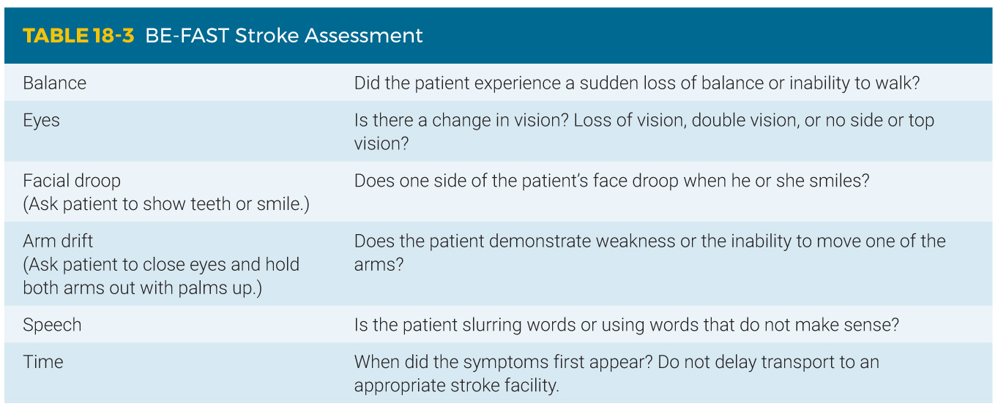
Secondary Assessment (3 of 8)
Notes:
The table on this slide displays the BE-FAST mnemonic

Slide 59
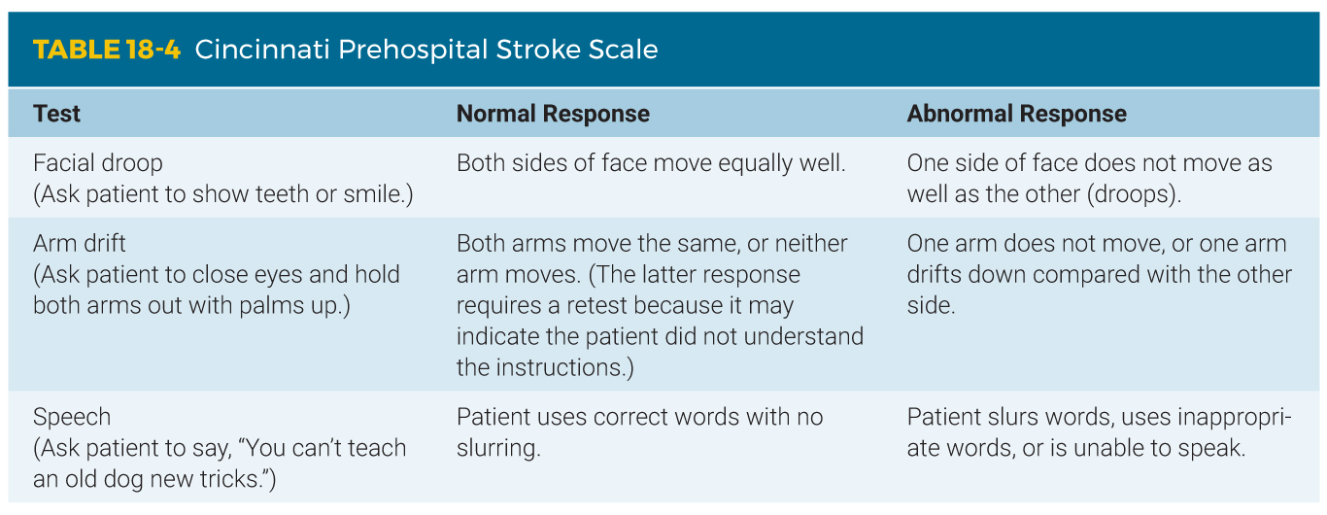
Secondary Assessment (4 of 8)
Notes:
The table on this slide displays the Cincinnati Prehospital Stroke Scale.

Slide 60
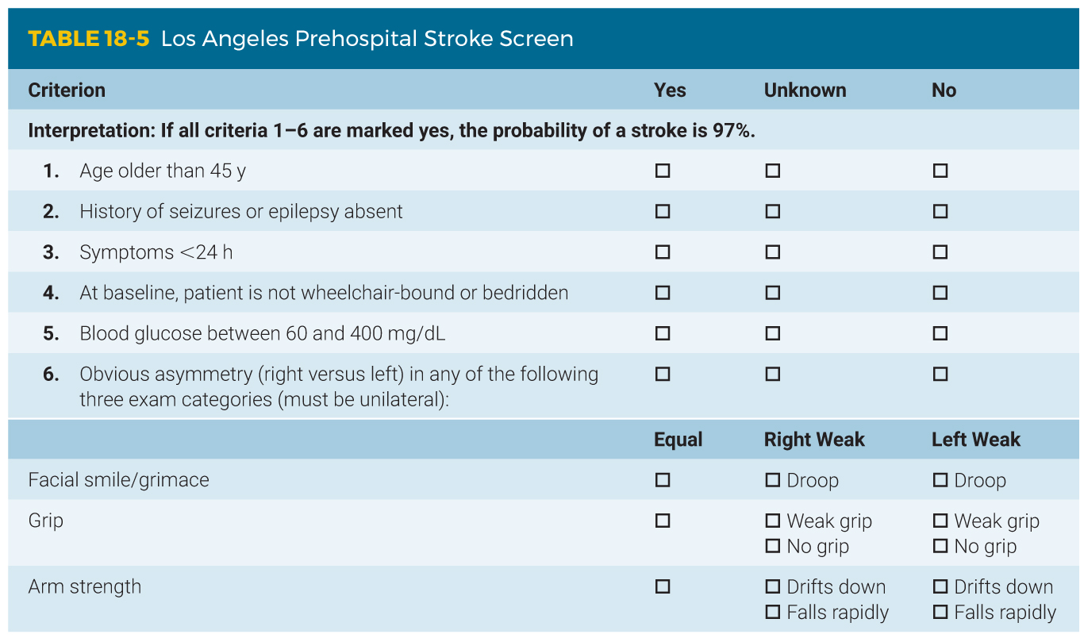
Secondary Assessment (5 of 8)
Notes:
The table on this slide displays the Los Angeles Prehospital Stroke Screen.

Slide 61
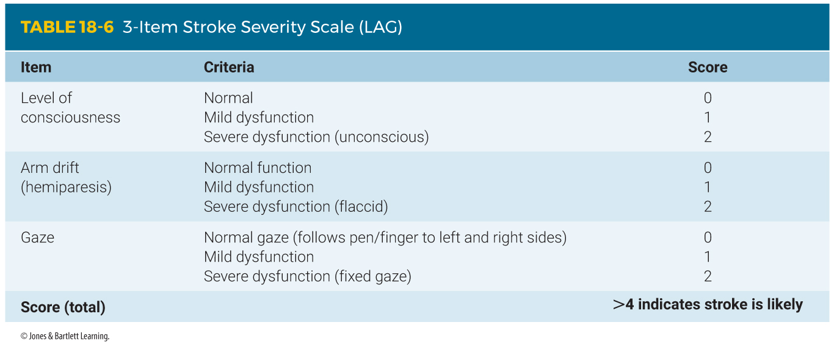
Secondary Assessment (6 of 8)
Notes:
The table on this slide displays the 3-Item Stroke Severity Scale (LAG).

Slide 62
Secondary Assessment (7 of 8)
All patients with an altered mental status should also have a Glasgow Coma Scale (GCS) score calculated.
Notes:
Lecture Outline
f. All patients with an altered mental status should also have a Glasgow Coma Scale (GCS) score calculated.

Slide 63
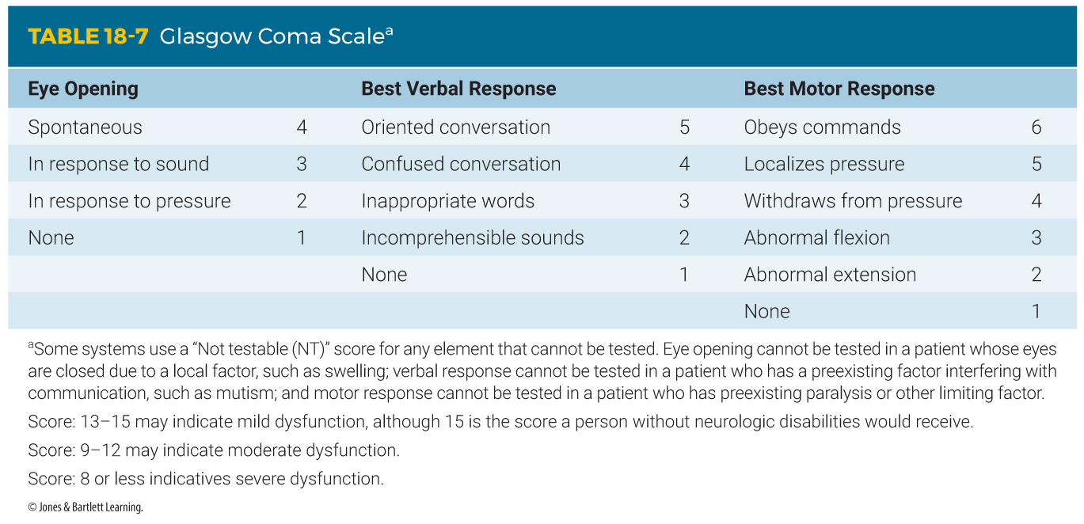
Secondary Assessment (8 of 8)
Notes:
The table on this slide displays the Glasgow Coma Scale (GCS).

Slide 64
Reassessment
Focus on reassessing the ABCs, vital signs, and interventions.
Compare baseline findings with updated information.
Watch carefully for changes in pulse, blood pressure, respirations, and GCS scores.
Notify the receiving facility of patient’s chief complaint and assessment findings.
Notes:
Lecture Outline
E. Reassessment
1. Focus on reassessing the ABCs, vital signs, and interventions.
2. Compare baseline findings with updated information,
3. Watch carefully for changes in pulse, blood pressure, respirations, and GCS scores.
4. Notify the receiving facility of patient’s chief complaint and assessment findings.

Slide 65
Emergency Medical Care (1 of 3)
ED physicians determine if there is bleeding in the brain for patients with a suspected stroke with a CT scan of the head.
    If no bleeding is present, the patient may be a candidate for blood clot dissolving medication.
Notify the hospital regarding the last time the patient was known to be without their current signs and symptoms of stroke.
Notes:
Lecture Outline
IX. Emergency Medical Care
A. General
1. In most patients with a suspected stroke, physicians in the emergency department need to determine whether there is bleeding in the brain.
a. If there is no bleeding, the patient may be a candidate for blood clot–dissolving medication.
b. If bleeding is present, this medication will increase bleeding with disastrous consequences.
c. Notify the hospital regarding the last time the patient was known to be without their current signs and symptoms of stroke.

Slide 66
Emergency Medical Care (2 of 3)
Patients who have had a seizure require definitive evaluation and treatment.
  Supplemental oxygen is strongly advised.
  For patients who are having a seizure:
    Protect them from harm.
    Maintain a clear airway by suctioning.
    Provide oxygen as quickly as possible.
    If head or neck trauma is suspected, provide spinal immobilization.
Notes:
Lecture Outline
2. Patients who have had a seizure require definitive evaluation and treatment in the hospital.
a. For patients who are having a seizure, protect them from harm; maintain a clear airway by suctioning; provide oxygen as quickly as possible; and, if head or neck trauma is suspected, provide spinal immobilization.

Slide 67
Emergency Medical Care (3 of 3)
For patients who continue to have a seizure, as in status epilepticus:
  Suction the airway.
  Provide positive pressure ventilations.
  Transport quickly to the hospital.
  Rendezvous with ALS, if possible.
Notes:
Lecture Outline
b. For patients who continue to have a seizure, as in status epilepticus:
i. Suction the airway.
ii. Provide positive pressure ventilations.
iii. Transport quickly to the hospital.
iv. Rendezvous with ALS, if possible.

Slide 68
Emergency Medical Care: Headache
You should be concerned if the patient complains of:
  A sudden-onset, severe headache
  A sudden headache with fever, seizures, altered mental status, or following trauma
Notes:
Lecture Outline
B. Headache
1. You should be concerned if the patient complains of:
a. A sudden-onset, severe headache
b. A sudden headache with fever, seizures, altered mental status, or following trauma

Slide 69
Emergency Medical Care: Migraine
Always assess the patient for other signs and symptoms that might indicate a more serious condition.
Apply high-flow oxygen, if tolerated.
Provide a darkened, quiet environment.
Do not use lights and siren during transport.
Notes:
Lecture Outline
2. Migraine
a. Always assess the patient for other signs and symptoms that might indicate a more serious condition.
b. Apply high-flow oxygen, if tolerated.
c. Provide a darkened and quiet environment.
d. Do not use lights and siren during transport.

Slide 70
Emergency Medical Care: Stroke
Support XABCs and provide rapid transport to a stroke center.
Maintain a SpO₂ level of at least 94%.
Oxygen therapy not recommended unless the patient is in respiratory distress or is hypoxic.
If possible, transport to a designated stroke center.
Notes:
Lecture Outline
C. Stroke
1. Support the ABCs and provide rapid transport to a stroke center.
2. Maintain a Spo₂ level of at least 94%.
3. Routine use of oxygen therapy is not recommended unless the patient is experiencing respiratory distress or is showing signs of hypoxia.
4. Fibrinolytic therapy and methods to mechanically remove the blood clot may reverse stroke symptoms and even stop the stroke if given within 3 hours (drugs) or 6 hours (mechanical methods).
5. If possible, transport to a designated stroke center.

Slide 71
Emergency Medical Care: Seizure (1 of 2)
The patient may be in a postictal state upon your arrival.
The patient may still be having a seizure:
  Continue to assess and treat XABCs.
  Protect the patient from harm.
Notes:
Lecture Outline
D. Seizure
1. The patient may be in postictal state upon your arrival.
2. The patient may still be having the seizure.
a. Continue to assess and treat XABCs.
b. Protect the patient from harm.

Slide 72
Emergency Medical Care: Seizure (2 of 2)
If the patient refuses transport after a seizure:
  Contact medical control.
  Follow local protocols.
Notes:
Lecture Outline
3. If the patient refuses transport after a seizure, contact online medical direction and ask them to speak directly with the patient.
4. Follow local protocols.

Slide 73
Emergency Medical Care: Altered Mental Status
Determine the cause.
Provide spinal motion restriction.
Provide airway and ventilation support.
Transport to the appropriate facility.
Notes:
Lecture Outline
E. Altered mental status
1. Determine the cause.
2. Provide spinal motion restriction, airway, and ventilatory support as indicated.
3. Transport to the appropriate facility.

Slide 74
Review
A 41-year-old man presents with slow, irregular breathing; hypotension; and dilated pupils. These signs MOST likely indicate dysfunction of the:
  brainstem.
  hypothalamus.
  cerebrum.
  cerebellum.

Slide 75
Review
Answer: A
Rationale: The brainstem is responsible for functions such as breathing, blood pressure, and pupil constriction. Brainstem dysfunction would result in abnormal findings with these functions.

Slide 76
Review
A 41-year-old man presents with slow, irregular breathing; hypotension; and dilated pupils. These signs MOST likely indicate dysfunction of the:
  brainstem.
  Rationale: Correct answer
  hypothalamus.
  Rationale: The hypothalamus causes changes to occur in the heart rate, body temperature, and thirst.
  cerebrum.
  Rationale: The cerebrum causes changes to occur in emotion, thought, touch, and movement.
  cerebellum.
  Rationale: The cerebellum causes changes to occur in muscle control, body coordination, standing, walking, and writing.

Slide 77
Review
An acute ischemic stroke is caused by:
  a ruptured cerebral artery.
  increased intracranial pressure.
  an acute rise in a person’s blood pressure.
  a blocked cerebral artery.

Slide 78
Review
Answer: D
Rationale: There are two types of stroke—hemorrhagic and ischemic. A hemorrhagic stroke is caused by a ruptured cerebral artery (aneurysm), which causes bleeding within the brain and increased intracranial pressure. An ischemic stroke is caused by a blocked cerebral artery—either from a clot that grows locally (thrombus) or that travels to the brain from another part of the body (embolus).

Slide 79
Review
An acute ischemic stroke is caused by:
  a ruptured cerebral artery.
  Rationale: This is known as a hemorrhagic stroke.
  increased intracranial pressure.
  Rationale: This can be caused by swelling, bleeding, or tumors.
  an acute rise in a person’s blood pressure.
  Rationale: This is known as a hypertensive crisis.
  a blocked cerebral artery.
  Rationale: Correct answer

Slide 80
Review
A 56-year-old man experienced a sudden, severe headache and then became unresponsive. He has a history of high blood pressure. The MOST likely cause of his condition is a(n):
  hemorrhagic stroke.
  acute ischemic stroke.
  severe migraine headache.
  transient ischemic attack.

Slide 81
Review
Answer: A
Rationale: Hemorrhagic strokes are typically preceded by a sudden, severe headache (signals the rupture of a cerebral artery), after which the patient becomes unresponsive due to bleeding within the brain. Ischemic strokes and transient ischemic attacks generally do not cause a sudden, severe headache, and migraine headaches typically do not cause a loss of consciousness.

Slide 82
Review
A 56-year-old man experienced a sudden, severe headache and then became unresponsive. He has a history of high blood pressure. The MOST likely cause of his condition is a(n):
  hemorrhagic stroke.
  Rationale: Correct answer
  acute ischemic stroke.
  Rationale: This generally does not cause a sudden, severe headache.
  severe migraine headache.
  Rationale: This generally does not cause a loss of consciousness.
  transient ischemic attack.
  Rationale: This generally does not cause a sudden, severe headache.

Slide 83
Review
Unlike an ischemic stroke, a transient ischemic attack is characterized by all of the following, EXCEPT:
  symptoms that resolve within 24 hours.
  symptoms that persist for longer than
  24 hours.
  weakness or paralysis to one side of the body.
  an acute onset of confusion and slurred speech.

Slide 84
Review
Answer: B
Rationale: Signs and symptoms of a transient ischemic attack (TIA) are usually identical to those of an acute ischemic stroke (eg, hemiparesis, slurred speech, confusion, facial droop). Unlike the ischemic stroke, however, the symptoms of a TIA usually resolve within 24 hours.

Slide 85
Review
Unlike an ischemic stroke, a transient ischemic attack is characterized by all of the following EXCEPT:
  symptoms that resolve within 24 hours.
  Rationale: This is a sign of a transient ischemic attack.
  symptoms that persist for longer than 24 hours.
  Rationale: Correct answer
  weakness or paralysis to one side of the body.
  Rationale: This is a sign of a transient ischemic attack.
  an acute onset of confusion and slurred speech.
  Rationale: This is a sign of a transient ischemic attack.

Slide 86
Review
A patient with a suspected stroke presents with slurred speech that is difficult for you to understand. This is referred to as:
  aphasia.
  dysphasia.
  dysphagia.
  dysarthria.

Slide 87
Review
Answer: D
Rationale: Dysarthria is defined as slurred, poorly articulated speech; it is common in stroke patients. Dysphasia is defined as difficulty speaking; the patient’s speech may or may not be slurred. Aphasia is the inability to speak. Dysphagia is defined as difficulty swallowing.

Slide 88
Review
A patient with a suspected stroke presents with slurred speech that is difficult for you to understand. This is referred to as:
  aphasia.
  Rationale: Aphasia is the inability to produce or understand speech.
  dysphasia.
  Rationale: Dysphasia is difficulty in speaking.
  dysphagia.
  Rationale: Dysphagia is difficulty in swallowing.
  dysarthria.
  Rationale: Correct answer

Slide 89
Review
A type of seizure that is characterized by severe twitching of all the body’s muscles and lasts for several minutes or longer is called a(n):
  partial seizure.
  absence seizure.
  tonic-clonic seizure.
  generalized seizure.

Slide 90
Review
Answer: D
Rationale: Generalized seizures are characterized by generalized severe twitching of all of the body’s muscles; they often last for several minutes or longer. An absence seizure is characterized by a blank stare; generalized muscle twitching is absent.

Slide 91
Review
A type of seizure that is characterized by severe twitching of all the body’s muscles and lasts for several minutes or longer is called a(n):
  partial seizure.
  Rationale: A partial seizure is broken down into simple (jerking of one part of the body) and complex (changes in behavior and emotion).
  absence seizure.
  Rationale: An absence seizure does not involve any changes in motor activity.
  tonic-clonic seizure.
  Rationale: A tonic-clonic seizure exhibits muscle contraction and incontinence.
  generalized seizure.
  Rationale: Correct answer

Slide 92
Review
The MOST important reason for promptly transporting a stroke patient to the hospital is:
  a transient ischemic attack can be ruled out.
  medications may be given to reverse the stroke.
  the clot in the coronary artery may be dissolved.
  he or she needs close blood pressure monitoring.

Slide 93
Review
Answer: B
Rationale: Fibrinolytic medications (clot busters) have been shown to reverse the symptoms of a stroke by dissolving the clot that is blocking the cerebral artery. However, for the patient to be eligible for this therapy, it must be initiated within 3 hours after the onset of symptoms. For this reason, prompt transport of the stroke patient is critical.

Slide 94
Review
The MOST important reason for promptly transporting a stroke patient to the hospital is because:
  a transient ischemic attack can be ruled out.
  Rationale: In a TIA, stroke symptoms resolve (on their own), usually in less than 24 hours with no neurologic deficits.
  medications may be given to reverse the stroke.
  Rationale: Correct answer
  the clot in the coronary artery may be dissolved.
  Rationale: The coronary artery is in the heart and not the brain.
  he or she needs close blood pressure monitoring.
  Rationale: Monitoring of a patient’s blood pressure is important, but dissolving the clot and stopping the progression of damage is more important.

Slide 95
Review
Which of the following are components of the Cincinnati Prehospital Stroke Scale?
  Arm drift, blood pressure, speech
  Speech, pupil response, arm drift
  Facial symmetry, speech, arm drift
  Pupil response, facial droop, speech

Slide 96
Review
Answer: C
Rationale: The three components of the Cincinnati Prehospital Stroke Scale are facial symmetry, speech, and arm drift. Both sides of the patient’s face should move symmetrically (equally) when he or she smiles. The patient’s speech should be easily understandable and without slurring. The patient should be able to hold both arms out in front of his or her body—with eyes closed and palms up—without one arm drifting down to his or her side.

Slide 97
Review
Which of the following are components of the Cincinnati Prehospital Stroke Scale?
  Arm drift, blood pressure, speech
  Rationale: The scale does not use blood pressure.
  Speech, pupil response, arm drift
  Rationale: The scale does not use pupil response.
  Facial symmetry, speech, arm drift
  Rationale: Correct answer
  Pupil response, facial droop, speech
  Rationale: The scale does not use pupil response.

Slide 98
Review
Your patient opens his eyes when you say his name, is making incomprehensible sounds, and withdraws when you pinch his earlobe. What is his GCS score?
  9
  8
  11
  12

Slide 99
Review
Answer: A
Rationale: The Glasgow Coma Scale gives a score of 3 to a patient who opens his or her eyes in response to speech. “Incomprehensible sounds” has a score of 2, and “withdraws to pain” has a score of 4. When added together, this patient’s GCS score is 9.

Slide 100
Review
Your patient opens his eyes when you say his name, is making incomprehensible sounds, and withdraws when you pinch his earlobe. What is his GCS score?
  9
  Rationale: Correct answer
  8
  Rationale: This is not the right score.
  11
  Rationale: This is not the right score.
  12
  Rationale: This is not the right score.

Slide 101
Review
If a patient complains of a severe migraine, how should she be transported?
  In a brightly lit ambulance so she can see while her vision is impaired
  With loud sirens so she can get to the hospital as soon as possible
  Without lights and siren
  This patient should not be transported.

Slide 102
Review
Answer: C
Rationale: Treatment of a migraine headache is supportive; however, you should always assess the patient for other signs and symptoms that might indicate a more serious condition. Applying high-flow oxygen, if tolerated, may help ease the patient’s condition. When possible, provide a darkened and quiet environment because patients are sensitive to light and sound. Do not use lights and siren during transport.

Slide 103
Review
If a patient complains of a severe migraine, how should she be transported?
  In a brightly lit ambulance so she can see while her vision is impaired
  Rationale: Migraine patients are sensitive to light.
  With loud sirens so she can get to the hospital as soon as possible
  Rationale: Migraine patients are sensitive to loud noises.
  Without lights and siren
  Rationale: Correct answer
  This patient should not be transported.
  Rationale: A migraine could indicate a more serious condition.

